Slide 1
Evaluation Metrics

Slide 2
Evaluation Metrics
Two main evaluation metrics for evaluating object detection algorithms are:
FPS (frame-per-second) to measure the network detection speed, and
mAP (mean Average Precision) to measure the network precision.

Slide 3
Evaluation Metrics
FPS TO MEASURE THE DETECTION SPEED
The most common metric that is used to measure the detection speed is the number of frames per second (FPS).
For example, Faster R-CNN operates at only 7 frames per second (FPS) whereas SSD operates at 59 FPS.
In benchmarking experiments, you will see the authors of a paper stating their network results as: “Network X achieves mAP of Y% at Z FPS”. Where X is the network name, Y is the mAP percentage, and Z is the FPS.

Slide 4
Evaluation Metrics
MEAN AVERAGE PRECISION (MAP)
The most common evaluation metric that is used in object recognition tasks is ‘mAP’, which stands for mean average precision.
It is a percentage from 0 to 100 and higher values are typically better, but it’s value is different from the accuracy metric in classification.
To understand how mean Average Precision (mAP) is calculated, you first need to understand the Intersection Over Union (IOU) and the Precision-Recall Curve (PR Curve). Let’s explain IOU and PR curve then come back to mAP.

Slide 5
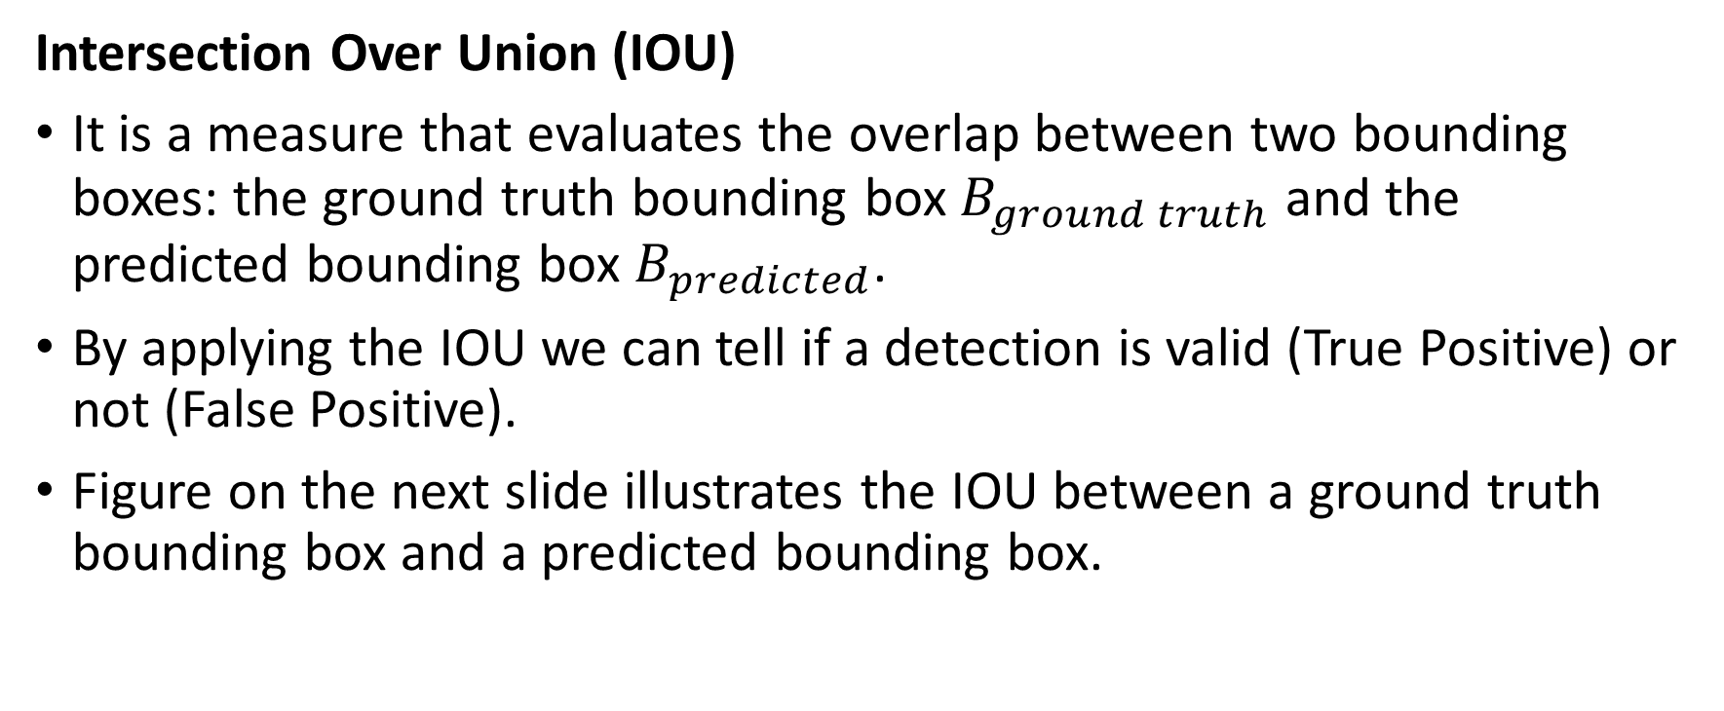
Evaluation Metrics
Intersection Over Union (IOU)
It is a measure that evaluates the overlap between two bounding boxes: the ground truth bounding box $B_{ground truth}$ and the predicted bounding box $B_{predicted}$.
By applying the IOU we can tell if a detection is valid (True Positive) or not (False Positive).
Figure on the next slide illustrates the IOU between a ground truth bounding box and a predicted bounding box.

Slide 6
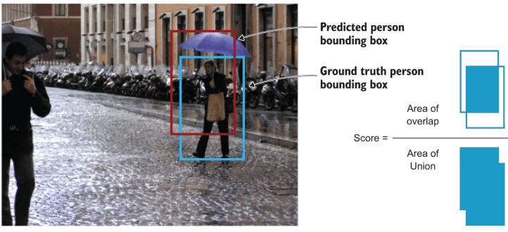
Evaluation Metrics
Intersection Over Union (IOU)

Slide 7
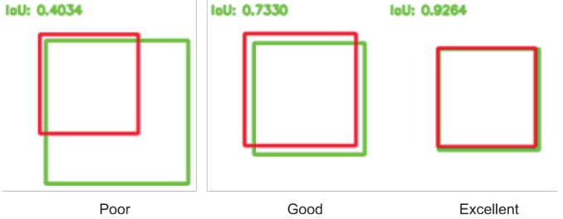
Evaluation Metrics
Intersection Over Union (IOU)
The intersection over the union value ranges from 0, meaning no overlap at all, to 1 which means that the two bounding boxes 100% overlap on each other.
The higher the overlap between the two bounding boxes (IOU value), the better.

Slide 8

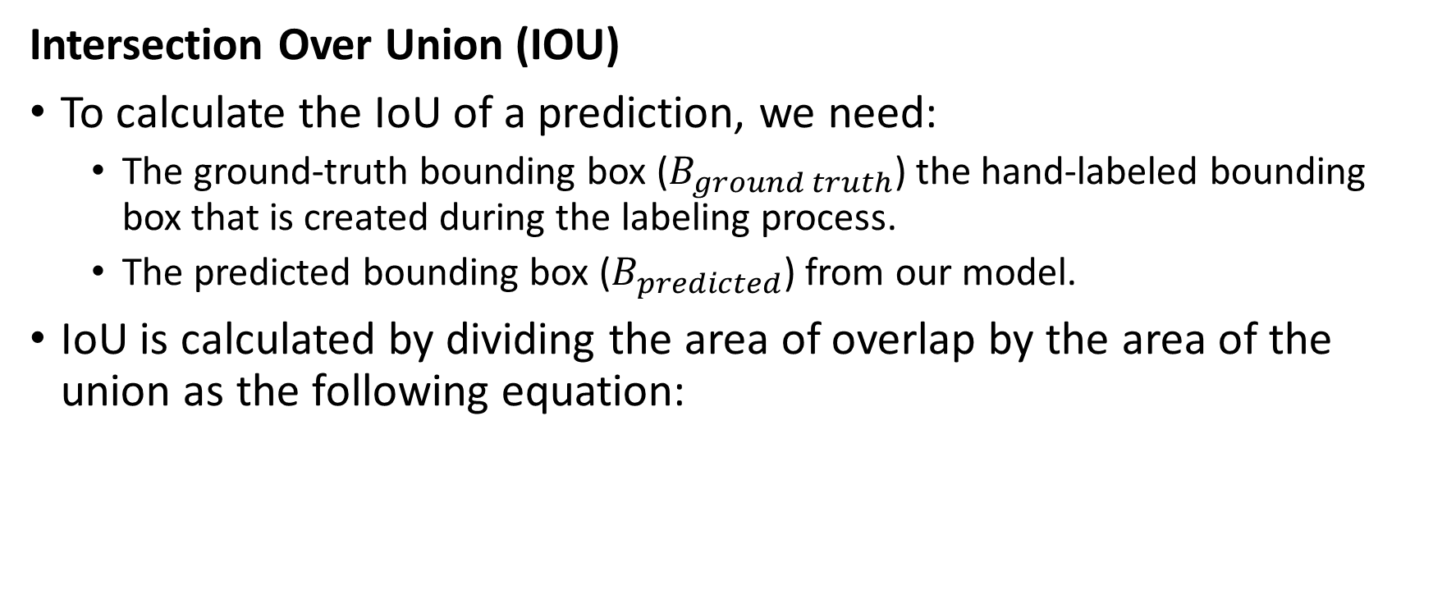
Evaluation Metrics
Intersection Over Union (IOU)
To calculate the IoU of a prediction, we need:
The ground-truth bounding box ($B_{ground truth}$) the hand-labeled bounding box that is created during the labeling process.
The predicted bounding box ($B_{predicted}$) from our model.
IoU is calculated by dividing the area of overlap by the area of the union as the following equation:

Slide 9
Evaluation Metrics
Intersection Over Union (IOU)
IoU is used to define a “correct prediction”.
Meaning, a “correct” prediction (True Positive) is one that has IoU greater than some threshold. This threshold is a tunable value depending on the challenge but 0.5 is a standard value.
For example, some challenges like MS COCO, uses mAP@0.5 meaning IoU threshold = 0.5 or mAP@0.75 meaning IoU threshold = 0.75.
This means that if the IoU is above this threshold is considered a True Positive (TP) and if it is below it is considered as a False Positive (FP).

Slide 10
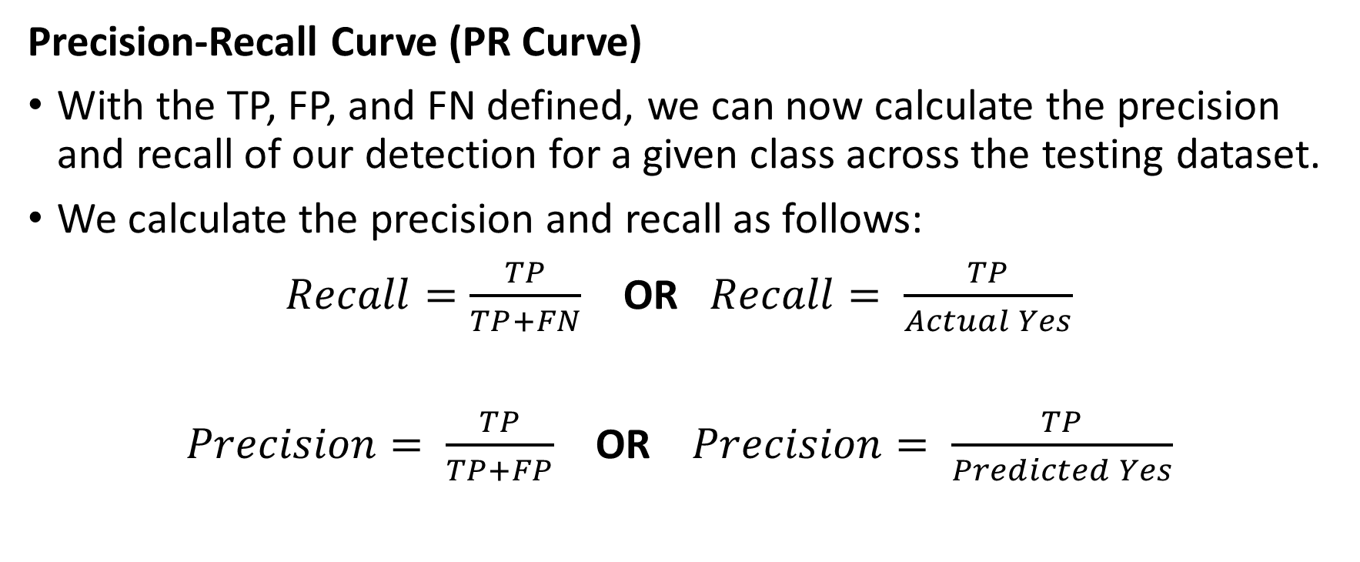
Evaluation Metrics
Precision-Recall Curve (PR Curve)
With the TP, FP, and FN defined, we can now calculate the precision and recall of our detection for a given class across the testing dataset.
We calculate the precision and recall as follows:
$Recall=\frac{TP}{TP+FN}$ OR $Recall= \frac{TP}{Actual Yes}$
$Precision= \frac{TP}{TP+FP}$ OR $Precision= \frac{TP}{Predicted Yes}$

Slide 11
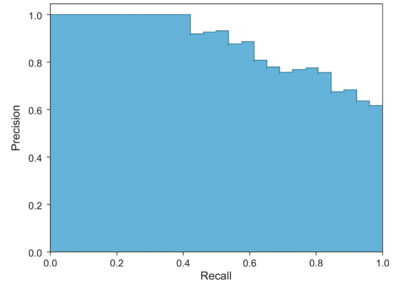
Evaluation Metrics
Precision-Recall Curve (PR Curve)
After calculating the precision and recall for all classes, the PR Curve is then plotted as follows:

Slide 12
Evaluation Metrics
Precision-Recall Curve (PR Curve)
The PR curve is a good way to evaluate the performance of an object detector as the confidence is changed by plotting a curve for each object class.
A detector is considered good if its precision stays high as recall increases, which means that if you vary the confidence threshold, the precision and recall will still be high.

Slide 13
Evaluation Metrics
Precision-Recall Curve (PR Curve)
Now, that we have the PR curve, we calculate the AP (Average Precision) by calculating the Area Under the Curve (AUC).
Then finally, mAP for object detection is the average of the AP calculated for all the classes.

Slide 14
Evaluation Metrics
MEAN AVERAGE PRECISION (MAP)
So, the mAP is calculated as follows:
Each bounding box will have an objectness score associated (probability of the box containing an object).
Precision and recall are calculated.
Precision-recall curve (PR curve) is computed for each class by varying the score threshold.
Calculate the average precision (AP): it is the area under the PR curve. In this step, the AP is computed for each class.
Calculate mAP: the average AP over all the different classes.

Slide 15
Deep Learning Pipeline
Any deep learning project, can be broken down into five common tasks:
Define and prepare problem
Summarize and understand data
Process and prepare data
Evaluate algorithms
Improve results

Slide 16
Deep Learning Pipeline
These tasks can either be combined and used together or broken down and used apart further, but this is the general structure.
To work through modeling deep learning problems in a pipeline, you need to map these tasks onto this process.
Sometimes you will see these tasks renamed or presented in a different structure, but in general they have the same purpose.

Slide 17
Deep Learning Pipeline
Define and Prepare Problem
Why do you collect data? There are questions that data you are collecting can help you answer: questions like which stocks should I invest in? or how can I understand my customers?
We can say that this step is about understanding the problem and its domain, and to understand, collect, and load everything you need to start working on your problem.
Like what is your data source and format? A database, a text file, an Excel file, coming from a web service etc. and how will you save the results? In a CSV file or Excel file or show in graphs/images etc.

Slide 18
Deep Learning Pipeline
Define and Prepare Problem
Which language and libraries will you use?
This is also the home of any global configuration you might need to do.
It is also the place where you might need to make a reduced sample of your dataset if it is too large to work with.
Ideally, your dataset should be small enough to build a model or create a visualization within a short period. You can always scale up well-performing models later.

Slide 19
Deep Learning Pipeline
Summarize and Understand Data
Data can be defined as observations of real-world phenomena, and as information that has been translated into a form that is efficient for movement or processing.
As examples, stock market data involves observations of daily stock prices, announcements of earnings by individual companies, and even opinion articles from pundits; or personal biometric data can include measurements of our minute-by-minute heart rate, blood sugar level, blood pressure, etc.

Slide 20
Deep Learning Pipeline
Summarize and Understand Data
As you need to work in the domain of these observations, you have to understand this domain and these observations.
You need to summarize and visualize these observations to understand them and be able to see trends.
Each piece of data provides a small window into a limited aspect of reality. The collection of all of these observations gives us a picture of the whole.

Slide 21
Deep Learning Pipeline
Summarize and Understand Data
This step is about better understanding the data that you have available. This includes understanding your data through
Descriptive statistics such as summaries
Use of data visualizations such as plots with Matplotlib, ideally using convenience functions from Pandas
Taking your time and using the results to prompt a lot of questions, assumptions, and hypotheses, which you can investigate later with specialized models

Slide 22
Deep Learning Pipeline
Process and Prepare Data
After understanding the domain and the data, you need to prepare it for the next step.
So, data processing is, generally, the collection and manipulation of items of data to produce meaningful information.
You can think that you have a small piece of the puzzle, and the goal is to solve it.
But the picture is messy because it is composed of a thousand little pieces, and in real-life data there’s always measurement noise and missing pieces.

Slide 23
Deep Learning Pipeline
Process and Prepare Data
So, by processing the data, you make it easier for the model to see the clear picture and understand it very well.
This is a crucial step in the pipeline, and the accuracy of the model depends on it.
This step is about preparing the data in such a way that it best exposes the structure of the problem and the relationships between your input attributes and the output variable.

Slide 24
Deep Learning Pipeline
Process and Prepare Data
This includes tasks such as the following:
Cleaning data by removing duplicates, marking missing values, and even imputing missing values
Feature selection where redundant features may be removed and new features developed
Data transforms where attributes are scaled or redistributed in order to best expose the structure of the problem later to learning algorithms

Slide 25
Deep Learning Pipeline
Evaluate Algorithms
This step is about finding a subset of machine learning algorithms that are good at exploiting the structure of your data. This involves steps such as:
Separating out a validation dataset to use for later confirmation of the skill of your developed model.
Or defining test options using scikit-learn, such as cross validation and the evaluation metric to use.

Slide 26
Deep Learning Pipeline
Evaluate Algorithms
Spot-checking a suite of linear and nonlinear machine learning algorithms.
Comparing the estimated accuracy of algorithms.
On a given problem you will likely spend most of your time on this and the previous step until you converge on a set of three to five well-performing machine learning algorithms.

Slide 27
Deep Learning Pipeline
Improve Results
Features and models sit between raw data and the desired insights.
In a machine learning workflow, we pick not only the model, but also the features.
Good features make the subsequent modeling step easy and the resulting model more capable of completing the desired task.
Bad features may require a much more complicated model to achieve the same level of performance.

Slide 28
Deep Learning Pipeline
Improve Results
Once you have a shortlist of machine learning algorithms, you need to get the most out of them.
There are two different ways to improve the accuracy of your models:
Search for a combination of parameters for each algorithm using scikit-learn that yields the best results.
Combine the prediction of multiple models into an ensemble prediction using ensemble techniques.
Once you have found a model that you believe can make accurate predictions on unseen data, you are ready to finalize it.

Slide 29
Deep Learning Pipeline
Improve Results
Finalizing a model may involve subtasks such as
Using an optimal model tuned by scikit-learn to make predictions on unseen data
Creating a standalone model using the parameters tuned by scikit-learn
Saving an optimal model to file for later use
Once you make it this far, you are ready to present results to stakeholders and/or deploy your model to start making predictions on unseen data.

